Slide 1
망고100 보드로 놀아보자-19
Android Ethernet 분석
http://cafe.naver.com/embeddedcrazyboys
http://www.mangoboard.com

Slide 2
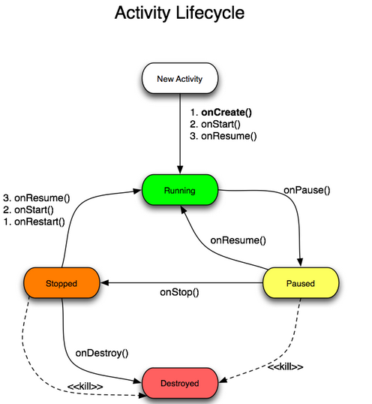
Android Activity Lifecycle

Slide 3
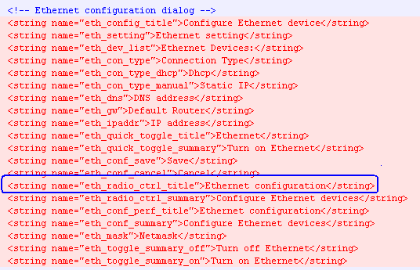
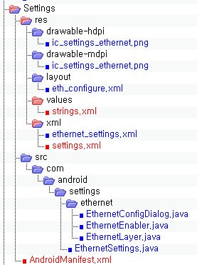
안드로이드 Ethernet Config 추가

Slide 4
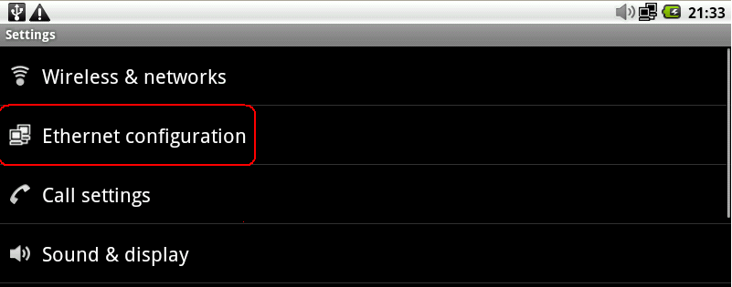
안드로이드 Ethernet Config 추가

Slide 5
Setting.xml 과 IconPreferenceScreen
<com.android.settings.IconPreferenceScreen
android:title="@string/eth_radio_ctrl_title"
settings:icon="@drawable/ic_settings_ethernet">
<intent
android:action="android.intent.action.MAIN"
android:targetPackage="com.android.settings"
android:targetClass="com.android.settings.EthernetSettings" />
</com.android.settings.IconPreferenceScreen>

Slide 6
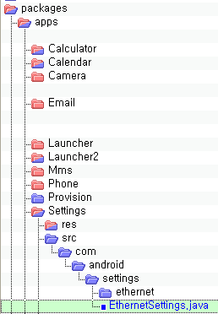
XML과 EthernetSettings class관계
<com.android.settings.IconPreferenceScreen
android:title="@string/eth_radio_ctrl_title"
settings:icon="@drawable/ic_settings_ethernet">
<intent
android:action="android.intent.action.MAIN"
android:targetPackage="com.android.settings"
android:targetClass="com.android.settings.EthernetSettings" />
</com.android.settings.IconPreferenceScreen>

Slide 7
Ethernet Service 초기화
(EthernetManager) getSystemService(ETH_SERVICE),
./packages/apps/Settings/src/com/android/settings/EthernetSettings.java
}else if (ETH_SERVICE.equals(name)) {
return getEthernetManager();
./frameworks/base/core/java/android/app/ApplicationContext.java
private EthernetManager getEthernetManager()
{
synchronized (sSync) {
if (sEthManager == null) {
IBinder b = ServiceManager.getService(ETH_SERVICE);
IEthernetManager service = IEthernetManager.Stub.asInterface(b);
sEthManager = new EthernetManager(service, mMainThread.getHandler());
./frameworks/base/core/java/android/app/ApplicationContext.java

Slide 8
Service Manager Ethernet 등록
private EthernetManager getEthernetManager()
{
synchronized (sSync) {
if (sEthManager == null) {
IBinder b = ServiceManager.getService(ETH_SERVICE);
IEthernetManager service = IEthernetManager.Stub.asInterface(b);
sEthManager = new EthernetManager(service, mMainThread.getHandler());
./frameworks/base/core/java/android/app/ApplicationContext.java
Connectivity service에서 등록
private ConnectivityService(Context context) {
….
ServiceManager.addService(Context.ETH_SERVICE, ethService);
./frameworks/base/services/java/com/android/server/ConnectivityService.java

Slide 9
Service Manager 역할
Service manager
POWER_SERVICE
ETH_SERVICE
…
CONNECTIVITY_SERVICE

Slide 10
Connectivity Service
Connectivity service
wifi
mms
….
ethernet

Slide 11
Ethernet service (부팅 시)
private ConnectivityService(Context context) {
if (DBG) Log.v(TAG, "ConnectivityService starting up");
if (DBG) Log.v(TAG, "Starting Ethernet Service");
mEthernetStateTracker = new EthernetStateTracker(context,mHandler);
EthernetService ethService = new EthernetService(context,
mEthernetStateTracker);
ServiceManager.addService(Context.ETH_SERVICE, ethService);
mNetTrackers[ConnectivityManager.TYPE_ETH] = mEthernetStateTracker;

Slide 12
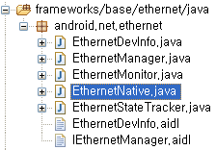
Ethernet service (부팅 시)
super는 자손클래스에서 조상클래스로부터 상속받은 멤버를 참조하는데 사용되는 참조변수
public EthernetStateTracker(Context context, Handler target) {
super(context, target, ConnectivityManager.TYPE_ETH, 0, "ETH", ""); Log.i(TAG,"Starts...");
if(EthernetNative.initEthernetNative() != 0 )
{
Log.e(TAG,"Can not init ethernet device layers");
return;
}

Slide 13
Ethernet service (부팅 시)
static JNINativeMethod gEthernetMethods[] = {
{"waitForEvent", "()Ljava/lang/String;“, (void *)android_net_ethernet_waitForEvent},
{"getInterfaceName", "(I)Ljava/lang/String;“, void )android_net_ethernet_getInterfaceName},
{"initEthernetNative", "()I“, (void *)android_net_ethernet_initEthernetNative},
{"getInterfaceCnt","()I“, (void *)android_net_ethernet_getInterfaceCnt}
};
static jint android_net_ethernet_initEthernetNative(JNIEnv *env,
jobject clazz)
{
if ((ret = netlink_init_interfaces_list()) < 0) {

Slide 14
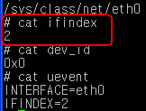
Ethernet service (부팅 시)
static int netlink_init_interfaces_list(void) {
..
if ((netdir = opendir(SYSFS_CLASS_NET)) != NULL) {
while((de = readdir(netdir))!=NULL) {
snprintf(path, SYSFS_PATH_MAX,"%s/%s/ifindex",SYSFS_CLASS_NET,de->d_name);
if ((ifidx = fopen(path,"r")) != NULL ) {
static const char SYSFS_CLASS_NET[] = "/sys/class/net";

Slide 15
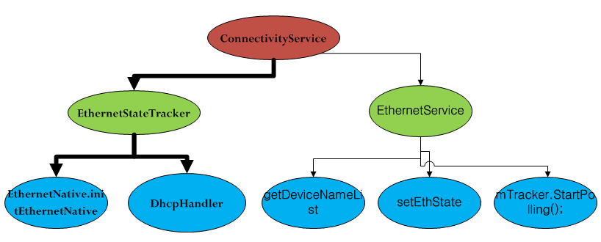
Ethernet service (부팅 시)

Slide 16
Ethernet Service 등록 Flow
private ConnectivityService(Context context) {
…
if (DBG) Log.v(TAG, "Starting Ethernet Service");
mEthernetStateTracker = new EthernetStateTracker(context,mHandler);
EthernetService ethService = new EthernetService(context,
mEthernetStateTracker);
public EthernetService(Context context, EthernetStateTracker Tracker){
mTracker = Tracker;
mContext = context;
isEthEnabled = getPersistedState();
Log.i(TAG,"Ethernet dev enabled " + isEthEnabled );
getDeviceNameList();
setEthState(isEthEnabled);
Log.i(TAG, "Trigger the ethernet monitor");
mTracker.StartPolling();
}

Slide 17
Ethernet Service 등록 Flow(계속)
public EthernetService(Context context, EthernetStateTracker Tracker){
…
getDeviceNameList();
}
public String[] getDeviceNameList() {
if (scanEthDevice() > 0 )
return DevName;
else
return null;
}

Slide 18
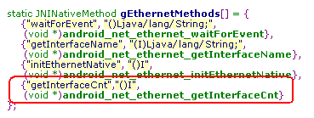
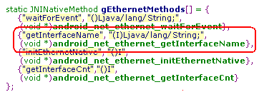
Ethernet Service 등록 Flow(계속)
private int scanEthDevice() {
int i = 0,j;
if ((i = EthernetNative.getInterfaceCnt()) != 0) {
Log.i(TAG, "total found "+i+ " net devices");
DevName = new String[i];
}
else
return i;
for (j = 0; j < i; j++) {
DevName[j] = EthernetNative.getInterfaceName(j);
if (DevName[j] == null)
break;
Log.i(TAG,"device " + j + " name " + DevName[j]);
}
return i;
}

Slide 19
Ethernet Service 등록 Flow(계속)
static jint android_net_ethernet_getInterfaceCnt() {
return total_int;
}
static jint android_net_ethernet_initEthernetNative(JNIEnv *env,
jobject clazz)
netlink_init_interfaces_list()
LOGI("interface %s:%d found",intfinfo->name,intfinfo->i);
add_int_to_list(intfinfo);//에서 total_int ++

Slide 20
Ethernet Service 등록 Flow(계속)
static jstring android_net_ethernet_getInterfaceName(JNIEnv *env, jobject clazz, jint index) {
info= interfaces;
if (total_int != 0 && index <= (total_int -1)) {
while (info != NULL) {
if (index == i) {
LOGI("Found :%s",info->name);
return env->NewStringUTF(info->name);
}
static jint android_net_ethernet_initEthernetNative(JNIEnv *env,
jobject clazz)
netlink_init_interfaces_list()
LOGI("interface %s:%d found",intfinfo->name,intfinfo->i);
add_int_to_list(intfinfo);//에서 Node 생성

Slide 21
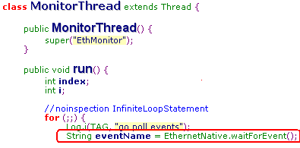
Ethernet Event 처리 쓰레드 생성
public EthernetService(Context context, EthernetStateTracker Tracker){
Log.i(TAG, "Trigger the ethernet monitor");
mTracker.StartPolling();
쓰레드 생성
static jstring android_net_ethernet_waitForEvent(JNIEnv *env,
jobject clazz)
{

Slide 22
이더넷이 연결된 경우(DHCP)
MonitorThread
EthernetMonitor
EthernetStateTracker
ConnectivityService

Slide 23
이더넷이 연결된 경우(DHCP)
static jstring android_net_ethernet_waitForEvent(JNIEnv *env,
jobject clazz)
{
if((len = recvmsg(nl_socket_poll, &msg, 0))>= 0) {
MonitorThread.run
.
} else if (cmd == NEW_LINK) {
event = PHYUP;
handleEvent(events[i],event);

Slide 24
이더넷이 연결된 경우(DHCP)
void handleEvent(String ifname,int event) {
switch (event) {
case PHYUP:
mTracker.notifyPhyConnected(ifname););
break;
public void notifyPhyConnected(String ifname) {
if synchronized(this) { this.sendEmptyMessage(EVENT_HW_PHYCONNECTED);
MonitorThread

Slide 25
이더넷이 연결된 경우(DHCP)
public void handleMessage(Message msg) {
..
case EVENT_HW_PHYCONNECTED:
try {
configureInterface(info);
}
private boolean configureInterface(EthernetDevInfo info) throws UnknownHostException {
if (info.getConnectMode().equals(EthernetDevInfo.ETH_CONN_MODE_DHCP)) {
mDhcpTarget.sendEmptyMessage(EVENT_DHCP_START);
DHCP Handler

Slide 26
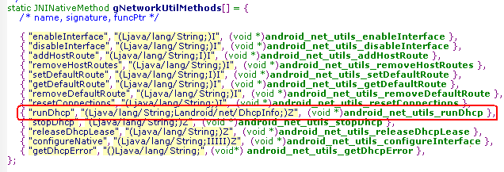
이더넷이 연결된 경우(DHCP)
public void handleMessage(Message msg) {
..
switch (msg.what) {
case EVENT_DHCP_START:
if (NetworkUtils.runDhcp(mInterfaceName, mDhcpInfo)) {}
static jboolean android_net_utils_runDhcp(JNIEnv* env, jobject clazz, jstring ifname, jobject info)
{
result = ::dhcp_do_request(nameStr, &ipaddr, &gateway, &mask,
&dns1, &dns2, &server, &lease);

