Slide 1
망고100 보드로 놀아보자-18
Android 메뉴 생성 및 아이콘 생성 (SPDIF,WM8960)
http://cafe.naver.com/embeddedcrazyboys
http://www.mangoboard.com

Slide 2
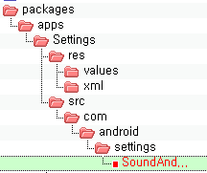
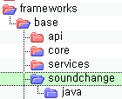
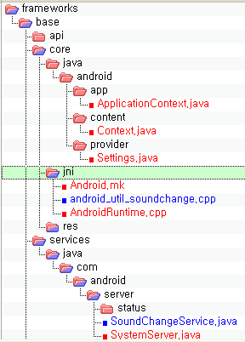
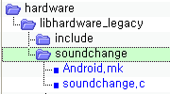
Android 구조
Application
Framework
Core Libraries&
Hardware Abstraction Layer
Linux Kernel

Slide 3
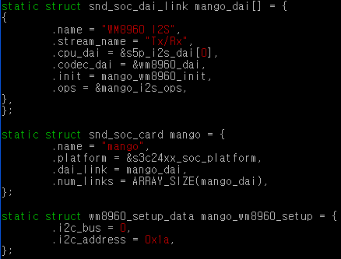
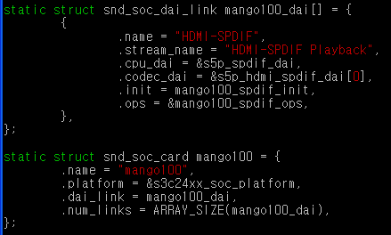
Android 메뉴 생성(커널 수정 ) (WM8960,SPDIF 드라이버 포함)
sound\soc\s3c24xx\Kconfig 파일에 아래와 같이 수정
config SND_MANGO100_WM8960
bool "WM8960 Driver"
depends on SND_S5P_MANGO100
select SND_SOC_WM8960
select SND_S5P_SOC_I2S
select SND_S3C_I2SV2_SOC
config SND_MANGO100_HDMI_SPDIF
bool "HDMI SPDIF Driver"
depends on SND_S5P_MANGO100
select SND_S5P_SPDIF

Slide 4
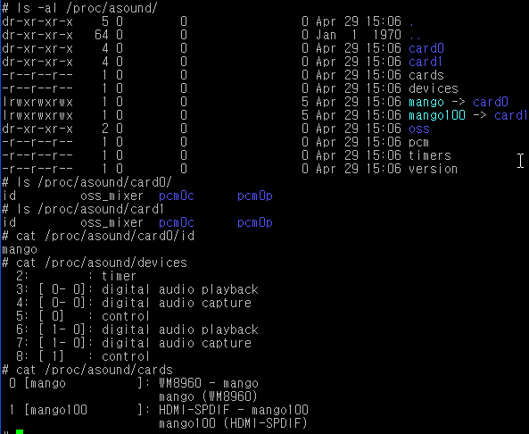
Android 메뉴 생성(커널 수정 ) (WM8960,SPDIF 드라이버 포함)

Slide 5
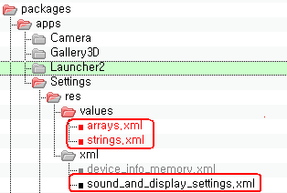
Android 메뉴 생성
packages\apps\Settings\res\values\arrays.xml
<!-- Sound Change Setting. -->
<string-array name="sound_change_entries">
<item>WM8960</item>
<item>SPDIF</item>
</string-array>
<!-- Do not translate. -->
<string-array name="sound_change_values" translatable="false">
<item>10</item>
<item>20</item>
</string-array>
packages\apps\Settings\res\values\strings.xml
<string name="sound_change">Sound Change Mode</string>
<!-- Sound & display settings screen, setting option summary to change Sound Driver -->
<string name="sound_change_summary">Choose Sound Driver Change mode</string>
<!-- Sound & display settings screen, setting option name to change Sound Driver Mode -->
packages\apps\Settings\res\xml\sound_and_display_settings.xml
<ListPreference
android:key="sound_change"
android:title="@string/sound_change"
android:summary="@string/sound_change_summary"
android:persistent="false"
android:entries="@array/sound_change_entries"
android:entryValues="@array/sound_change_values" />

Slide 6
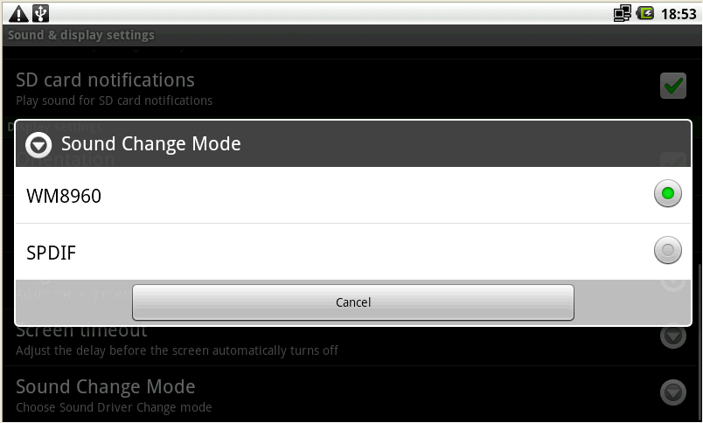
Android 메뉴 생성

Slide 7
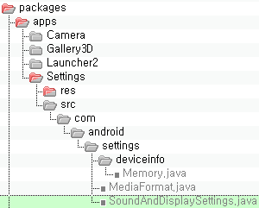
Android 메뉴 생성 SoundAndDisplaySettings.java
import static android.provider.Settings.System.SOUND_CHANGE;
import android.util.soundchange.SoundChangeManager;
public class SoundAndDisplaySettings extends PreferenceActivity implements
Preference.OnPreferenceChangeListener {
private static final String TAG = "SoundAndDisplaysSettings";
/** If there is no setting in the provider, use this. */
private static final int FALLBACK_SCREEN_TIMEOUT_VALUE = 30000;
private static final int FALLBACK_SOUND_CHANGE_VALUE = 10;
private static final int FALLBACK_EMERGENCY_TONE_VALUE = 0;
private static final String KEY_SILENT = "silent";
private static final String KEY_VIBRATE = "vibrate";
private static final String KEY_SCREEN_TIMEOUT = "screen_timeout";
private static final String KEY_SOUND_CHANGE = "sound_change";
private SoundChangeManager mSoundChangeManager;
ListPreference SoundChangePreference =
(ListPreference) findPreference(KEY_SOUND_CHANGE);
SoundChangePreference.setValue(String.valueOf(Settings.System.getInt(
resolver, SOUND_CHANGE, FALLBACK_SOUND_CHANGE_VALUE)));
SoundChangePreference.setOnPreferenceChangeListener(this);
mSoundChangeManager = (SoundChangeManager) getSystemService(SOUNDCHANGE_SERVICE);
./packages/apps/Settings/src/com/android/settings/SoundAndDisplaySettings.java
public static final String SOUND_CHANGE = "sound_change";
./frameworks/base/core/java/android/provider/Settings.java

Slide 8
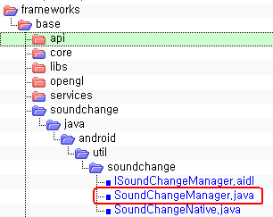
Android 메뉴 생성 SoundAndDisplaySettings.java
import android.util.soundchange.SoundChangeManager;
./packages/apps/Settings/src/com/android/settings/SoundAndDisplaySettings.java
SoundChangeManager.java,ISoundChangeManager.aidl,SoundChangeNative.java
소스 추가
package android.util.soundchange;
import java.util.List;
import android.annotation.SdkConstant;
import android.annotation.SdkConstant.SdkConstantType;
import android.os.Handler;
import android.os.RemoteException;
import android.util.Log;
public class SoundChangeManager {

Slide 9
Android 메뉴 생성 SoundAndDisplaySettings.java
private SoundChangeManager mSoundChangeManager;
ListPreference SoundChangePreference =
(ListPreference) findPreference(KEY_SOUND_CHANGE);
SoundChangePreference.setValue(String.valueOf(Settings.System.getInt(
resolver, SOUND_CHANGE, FALLBACK_SOUND_CHANGE_VALUE)));
SoundChangePreference.setOnPreferenceChangeListener(this);
mSoundChangeManager = (SoundChangeManager) getSystemService(SOUNDCHANGE_SERVICE);
./packages/apps/Settings/src/com/android/settings/SoundAndDisplaySettings.java
public Object getSystemService(String name) {
..
}else if (SOUNDCHANGE_SERVICE.equals(name)) {
return getSoundChangeManager();
./frameworks/base/core/java/android/app/ApplicationContext.java
private SoundChangeManager getSoundChangeManager()
{
synchronized (sSync) {
if (sSoundChangeManager == null) {
IBinder b = ServiceManager.getService(SOUNDCHANGE_SERVICE);
ISoundChangeManager service = ISoundChangeManager.Stub.asInterface(b);
sSoundChangeManager = new SoundChangeManager(service);
}
}
return sSoundChangeManager;
}./frameworks/base/core/java/android/app/ApplicationContext.java

Slide 10
Android 메뉴 생성 SoundAndDisplaySettings.java
APP
mSoundChangeManager = (SoundChangeManager) getSystemService(SOUNDCHANGE_SERVICE);
FRAMEWORK
public Object getSystemService(String name) {..
FRAMEWORK
private SoundChangeManager getSoundChangeManager(){
./packages/apps/Settings/src/com/android/settings/SoundAndDisplaySettings.java
./frameworks/base/core/java/android/app/ApplicationContext.java
}./frameworks/base/core/java/android/app/ApplicationContext.java

Slide 11
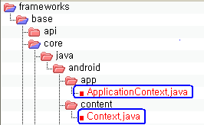
Android Framework
public Object getSystemService(String name) {
..
}else if (SOUNDCHANGE_SERVICE.equals(name)) {
return getSoundChangeManager();
./frameworks/base/core/java/android/app/ApplicationContext.java
public static final String SOUNDCHANGE_SERVICE = "soundchange";
./frameworks/base/core/java/android/content/Context.java

Slide 12
Android Framework
private SoundChangeManager getSoundChangeManager()
{
synchronized (sSync) {
if (sSoundChangeManager == null) {
IBinder b = ServiceManager.getService(SOUNDCHANGE_SERVICE);
ISoundChangeManager service = ISoundChangeManager.Stub.asInterface(b);
sSoundChangeManager = new SoundChangeManager(service);
}
}
return sSoundChangeManager;
./frameworks/base/core/java/android/app/ApplicationContext.java
soundchange = new SoundChangeService(context); ServiceManager.addService(Context.SOUNDCHANGE_SERVICE, soundchange);
./frameworks/base/services/java/com/android/server/SystemServer.java
package com.android.server;
public class SoundChangeService<syncronized> extends ISoundChangeManager.Stub{
private static final String TAG = "SoundChangeService";
public SoundChangeService(Context context){
mContext = context;
mPreSoundChangeState = getPersistedState();
setSoundChangeMode(mPreSoundChangeState);
}
frameworks\base\services\java\com\android\server\SoundChangeService.java

Slide 13
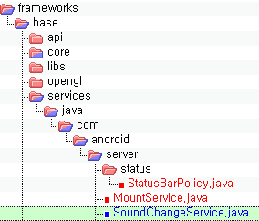
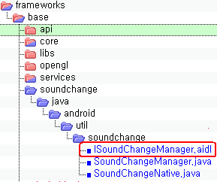
Android Framework(Binder)
private SoundChangeManager getSoundChangeManager()
{
synchronized (sSync) {
if (sSoundChangeManager == null) {
IBinder b = ServiceManager.getService(SOUNDCHANGE_SERVICE);
ISoundChangeManager service = ISoundChangeManager.Stub.asInterface(b);
sSoundChangeManager = new SoundChangeManager(service);
}
}
return sSoundChangeManager;
./frameworks/base/core/java/android/app/ApplicationContext.java
public class SoundChangeService<syncronized> extends ISoundChangeManager.Stub{
import android.util.soundchange.ISoundChangeManager;
./frameworks/base/core/java/android/app/ApplicationContext.java

Slide 14
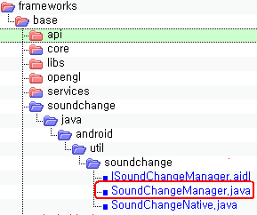
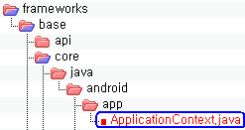
Android Framework(Binder)
private SoundChangeManager getSoundChangeManager()
{
synchronized (sSync) {
if (sSoundChangeManager == null) {
IBinder b = ServiceManager.getService(SOUNDCHANGE_SERVICE);
ISoundChangeManager service = ISoundChangeManager.Stub.asInterface(b);
sSoundChangeManager = new SoundChangeManager(service);
}
}
return sSoundChangeManager;
./frameworks/base/core/java/android/app/ApplicationContext.java
ISoundChangeManager mService;
public SoundChangeManager(ISoundChangeManager service) {
Log.i(TAG, "Init SoundChange Manager");
mService = service;
}
import android.util.soundchange.SoundChangeManager;

Slide 15
Android 메뉴 생성 SoundAndDisplaySettings.java
public boolean onPreferenceChange(Preference preference, Object objValue) {
…
} else if (KEY_SOUND_CHANGE.equals(key)) {
int value = Integer.parseInt((String) objValue);
try {
Settings.System.putInt(getContentResolver(),
SOUND_CHANGE, value);
} catch (NumberFormatException e) {
Log.e(TAG, "could not persist sound change mode setting", e);
}
// update value
mSoundChangeManager.setSoundChangeMode(value);
. packages\apps\Settings\src\com\android\settings\SoundAndDisplaySettings.java
private static final String KEY_SOUND_CHANGE = "sound_change";
. packages\apps\Settings\src\com\android\settings\SoundAndDisplaySettings.java
<ListPreference
android:key="sound_change“
packages\apps\Settings\res\xml\sound_and_display_settings.xml

Slide 16
Android 메뉴 생성 SoundAndDisplaySettings.java
else if (KEY_SOUND_CHANGE.equals(key
android:key="sound_change“
private static final String KEY_SOUND_CHANGE = "sound_change";

Slide 17
Android 메뉴 생성(APP~JNI)
./packages/apps/Settings/src/com/android/settings/SoundAndDisplaySettings.java
mSoundChangeManager.setSoundChangeMode(value);
./frameworks/base/services/java/com/android/server/SoundChangeService.java
setSoundChangeMode(mPreSoundChangeState);
SoundChangeNative.SoundDriverChange(mode);
./frameworks/base/soundchange/java/android/util/soundchange/SoundChangeNative.java
public native static void SoundDriverChange(int mode);}

Slide 18
Android Framework(JNI)
service
SoundChangeNative.SoundDriverChange(mode);
./frameworks/base/services/java/com/android/server/SoundChangeService.java
JNI
public native static void SoundDriverChange(int mode);
./frameworks/base/soundchange/java/android/util/soundchange/SoundChangeNative.java
JNI
{ "SoundDriverChange", "(I)V", (void*)android_util_soundchange_SoundChangeManager },
./frameworks/base/core/jni/android_util_soundchange.cpp

Slide 19
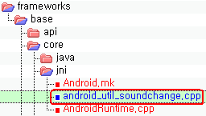
Android Framework(JNI)
int register_android_util_soundchange_SoundChangeManager(JNIEnv* env)
{
return AndroidRuntime::registerNativeMethods(env,
"android/util/soundchange/SoundChangeNative", g_methods, NELEM(g_methods));
}
public class SoundChangeNative {
public native static void SoundDriverChange(int mode);
}./frameworks/base/soundchange/java/android/util/soundchange/SoundChangeNative.java
static JNINativeMethod g_methods[] = {
{ "SoundDriverChange", "(I)V", (void*)android_util_soundchange_SoundChangeManager },
};

Slide 20
Android Framework(JNI~HAL)
android_util_soundchange_SoundChangeManager()
{::sound_change_service(mode);}
./frameworks/base/core/jni/android_util_soundchange.cpp
int sound_change_service(int mode)
hardware/libhardware_legacy/soundchange/soundchange.c
file_copy("/system/etc/asound_wm8960.conf",”/system/etc/asound.conf");

Slide 21
Android Framework(LIB~HAL)
./frameworks/base/core/jni/android_util_soundchange.cpp
::sound_change_service(mode);
./hardware/libhardware_legacy/soundchange/soundchange.c
int sound_change_service(int mode)
libandroid_runtime.so

Slide 22
Libruntime.so등록하기 (core Libraries)
extern int register_android_util_soundchange_SoundChangeManager(JNIEnv* env);
REG_JNI(register_android_util_soundchange_SoundChangeManager),
frameworks\base\core\jni\AndroidRuntime.cpp 에 추가

Slide 23
Android 메뉴 생성 (aidl등록)
LOCAL_SRC_FILES += \
soundchange/java/android/util/soundchange/ISoundChangeManager.aidl \
. Frameworks/base/Android.mk 파일에 추가
LOCAL_SRC_FILES := $(call find-other-java-files,$(FRAMEWORKS_BASE_SUBDIRS))
define find-other-java-files
$(call find-subdir-files,$(1) -name "*.java" -and -not -name ".*")
Endef
./build/core/definitions.mk

Slide 24
Android (current.xml)
frameworks\base\api\current.xml
<field name="SOUNDCHANGE_SERVICE"
type="java.lang.String"
transient="false"
volatile="false"
value="&quot;soundchange&quot;"
static="true"
final="true"
deprecated="not deprecated"
visibility="public"
>
</field>
<field name="SOUND_CHANGE"
type="java.lang.String"
transient="false"
volatile="false"
value="&quot;sound_change&quot;"
static="true"
final="true"
deprecated="not deprecated"
visibility="public"
>
</field>
make update-api : 새로 추가된 java class 를 android platform 에 등록.
#make update-api를 실행하면 current.xml이 자동으로 등록 됨
#make
update-api: $(INTERNAL_PLATFORM_API_FILE) | $(ACP)
./build/core/tasks/apicheck.mk

Slide 25
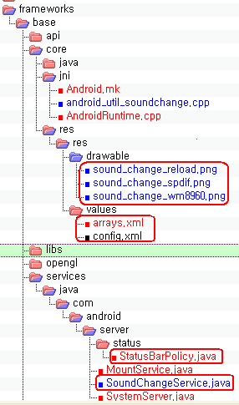
Android 아이콘 생성
아이콘이미지
else if (action.equals(SoundChangeManager.SOUND_CHANGE_STATE_CHANGED_ACTION)){
updateSoundChange(intent);
Control
(SoundChangeManager.SOUND_CHANGE_STATE_CHANGED_ACTION)

Slide 26
Android 아이콘 생성
final Intent intent = new Intent(SoundChangeManager.SOUND_CHANGE_STATE_CHANGED_ACTION);
mContext.sendStickyBroadcast(intent);
./frameworks/base/services/java/com/android/server/SoundChangeService.java
filter.addAction(SoundChangeManager.SOUND_CHANGE_STATE_CHANGED_ACTION);
private BroadcastReceiver mIntentReceiver = new BroadcastReceiver() {
else if (action.equals(SoundChangeManager.SOUND_CHANGE_STATE_CHANGED_ACTION)){
updateSoundChange(intent);
./frameworks/base/services/java/com/android/server/status/StatusBarPolicy.java
updateSoundChange(intent);

Slide 27
Android 아이콘 생성
private final void updateSoundChange(Intent intent) {
final int event = intent.getIntExtra(SoundChangeManager.EXTRA_SOUND_CHANGE_STATE, SoundChangeManager.SOUND_CHANGE_STATE_UNKNOWN);
int iconId;
switch (event) {
case SoundChangeManager.SOUND_CHANGE_STATE_WM8960:
default:
iconId = sSoundChangeImages[0];
break;
case SoundChangeManager.SOUND_CHANGE_STATE_SPDIF:
iconId = sSoundChangeImages[1];
break;
case SoundChangeManager.SOUND_CHANGE_STATE_RELOAD:
iconId = sSoundChangeImages[2];
break;
}
mSoundChangeData.iconId = iconId;
mService.updateIcon(mSoundChangeIcon, mSoundChangeData, null);
}
intent.putExtra(SoundChangeManager.EXTRA_SOUND_CHANGE_STATE, mode);
./frameworks/base/services/java/com/android/server/status/StatusBarService.java

Slide 28
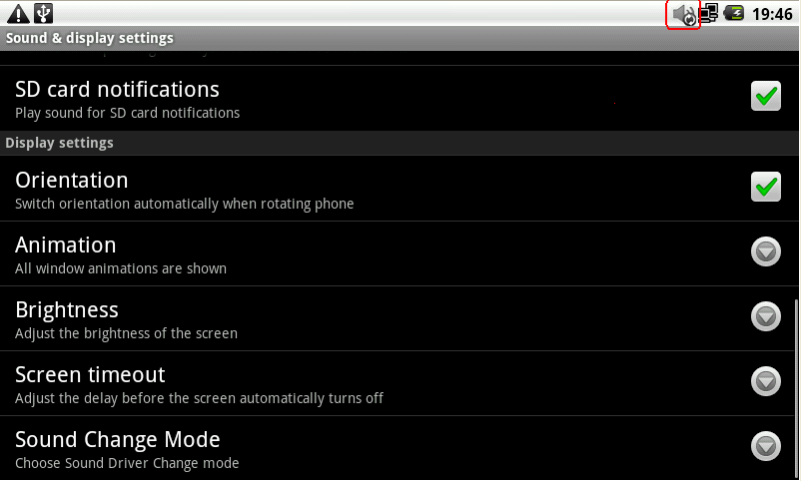
안드로이드 아이콘 생성 결과

Slide 29
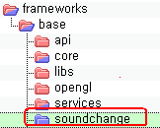
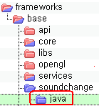
안드로이드 메뉴 생성(build)
build\core\pathmap.mk 파일 수정
FRAMEWORKS_BASE_SUBDIRS := \
$(addsuffix /java, \
core \
graphics \
location \
media \
opengl \
sax \
telephony \
ethernet \
wifi \
vpn \
keystore \
soundchange \
)
FRAMEWORKS_BASE_JAVA_SRC_DIRS := \
$(addprefix frameworks/base/,$(FRAMEWORKS_BASE_SUBDIRS))
addsuffix /java

Slide 30
안드로이드 메뉴 생성(aidl)
frameworks\base\Android.mk 파일 수정
# FRAMEWORKS_BASE_SUBDIRS comes from build/core/pathmap.mk
LOCAL_SRC_FILES := $(call find-other-java-files,$(FRAMEWORKS_BASE_SUBDIRS))
LOCAL_SRC_FILES := $(filter-out \
org/mobilecontrol/% \
,$(LOCAL_SRC_FILES))
ifeq ($(TARGET_BUILD_TYPE),debug)
LOCAL_SRC_FILES += $(call find-other-java-files,core/config/debug)
else
LOCAL_SRC_FILES += $(call find-other-java-files,core/config/ndebug)
endif
LOCAL_SRC_FILES += \
ethernet/java/android/net/ethernet/IEthernetManager.aidl \
soundchange/java/android/util/soundchange/ISoundChangeManager.aidl \
AIDL은 Android Interface description language의 약자

Slide 31
Android build (find-other-java-files)
LOCAL_SRC_FILES := $(call find-other-java-files,$(FRAMEWORKS_BASE_SUBDIRS))
define find-other-java-files
$(call find-subdir-files,$(1) -name "*.java" -and -not -name ".*")
Endef
./build/core/definitions.mk

Slide 32
안드로이드 메뉴 생성
frameworks\base\core\java\android\app\ApplicationContext.java에 추가
import android.util.soundchange.ISoundChangeManager;
import android.util.soundchange.SoundChangeManager;
frameworks\base\soundchange\java\android\util\soundchange\SoundChangeManager.java 를 포함
package android.util.soundchange;
import java.util.List;
import android.annotation.SdkConstant;
frameworks\base\soundchange\java\android\util\soundchange\ISoundChangeManager.aidl
package android.util.soundchange;
interface ISoundChangeManager
{
int getSoundChangeStatus();
int getPreSoundChangeStatus();
void setSoundChangeMode(int mode);
}

Slide 33
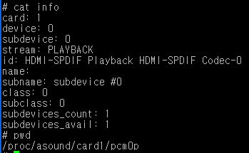
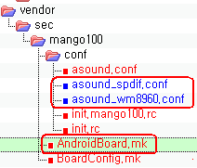
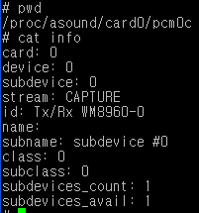
Build 환경 구성
ctl.AndroidPlayback {
type hw
card 1
}
ctl.AndroidPlayback {
type hw
card 0
}
PRODUCT_COPY_FILES += \
vendor/sec/mango100/conf/asound.conf:system/etc/asound.conf \
vendor/sec/mango100/conf/asound_wm8960.conf:system/etc/asound_wm8960.conf \
vendor/sec/mango100/conf/asound_spdif.conf:system/etc/asound_spdif.conf \

Slide 34
안드로이드 아이콘 생성
<item><xliff:g id="id">soundchange</xliff:g></item>
\frameworks\base\core\res\res\values\arrays.xml 파일에 추가
<!-- Declared at res/drawable/sound_change_reload.png:0 -->
<public type="drawable" name="sound_change_reload" id="0x01080271" />
./out/target/common/obj/APPS/framework-res_intermediates/public_resources.xml

Slide 35
SD Card 인식(Froyo)
부팅 후 아래와 같이 수정
dev_mount sdcard /mnt/sdcard auto /devices/platform/s3c-sdhci.0/mmc_host/mmc0
또는
vendor/sec/mango100/conf/vold.fstab 파일을 아래와 같이 수정
dev_mount sdcard /mnt/sdcard auto /devices/platform/s3c-sdhci.0/mmc_host/mmc0

Slide 36
ALSA Sound 소스 받기(froyo)
#vi .repo/manifest.xml 을 수정
<project path="external/alsa-lib" name="platform/external/alsa-lib" />
<project path="external/alsa-utils" name="platform/external/alsa-utils" />
<project path="hardware/alsa_sound" name="platform/hardware/alsa_sound" />
#repo sync
#ls external
#ls hardware

Slide 37
ALSA Sound 설정(froyo)
build/target/board/generic/BoardConfig.mk
을 추가
BOARD_USES_GENERIC_AUDIO := false
BUILD_WITH_ALSA_UTILS := true
BOARD_USES_ALSA_AUDIO := true
-asound.conf 파일을 작성 파일 시스템에 복사
# cp asound.conf system/usr/share/alsa_sound/
또는
build/target/board/generic/AndroidBoard.mk 파일에 아래와 같이 수정
PRODUCT_COPY_FILES += \
build/target/board/generic/conf/asound.conf:system/etc/asound.conf

Slide 38
Patch 만들기 , 사용법
#diff –urN SRC DES소스 > xxx.diff
#cat xxx.diff | patch –p1
http://crztech.iptime.org:8080/Release/mango100/eclair/android-menu-patch.tar 다운받기
# cd mango100_eclair_2010_06_30
# cat ../../mango100-eclair-menu.diff | patch -p1
# cp sound_change_reload.png frameworks/base/core/res/res/drawable/
#cp sound_change_spdif.png frameworks/base/core/res/res/drawable/
# cp sound_change_wm8960.png frameworks/base/core/res/res/drawable/

