Slide 1
망고100 보드로 놀아보자-15
UART,Keypad,이더넷 드라이버
안드로이드에서 키 처리
http://cafe.naver.com/embeddedcrazyboys

Slide 2
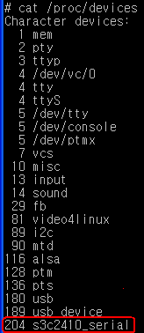
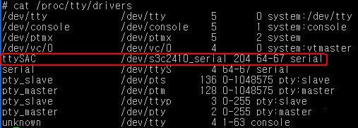
DEBUG PORT 포팅
$(topdir)./config 파일에서
CONFIG_S3C_LOWLEVEL_UART_PORT=1
# CONFIG_SPLIT_ROOT_FILESYSTEM is not set
Kernel configuration에서
“kernel hacking-> S3C UART to use for low-level debug “
에서 1 선택
./arch/arm/plat-s3c/include/plat/uncompress.h 소스에 포함
#define uart_base S3C_PA_UART + (S3C_UART_OFFSET * CONFIG_S3C_LOWLEVEL_UART_PORT)
.dev_name = "s3c2410_serial",
./drivers/serial/samsung.c 에서 디바이스 이름을 수정 할 수 있습니다.

Slide 3
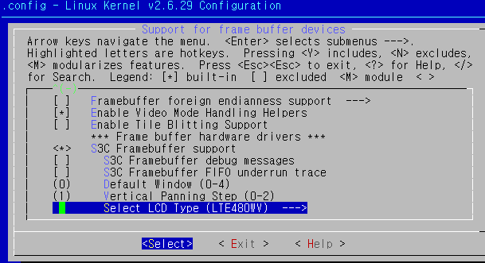
LCD 드라이버 수정-1
#make menuconfig
“Device Drivers->Graphic Support
->Support for frame buffer devices
->S3C Framebuffer support 선택

Slide 4
LCD 드라이버 수정-2
void lcd_power_ctrl(s32 value)
{
int err;
if (value) {
if (gpio_is_valid(S5PC1XX_GPH0(2))) {
err = gpio_request(S5PC1XX_GPH0(2), "GPH0");
if (err) {
printk(KERN_ERR "failed to request GPH0 for "
"lcd reset control\n");
}
gpio_direction_output(S5PC1XX_GPH0(2), 1);
}
}
else {
if (gpio_is_valid(S5PC1XX_GPH0(2))) {
err = gpio_request(S5PC1XX_GPH0(2), "GPH0");
if (err) {
printk(KERN_ERR "failed to request GPH0 for "
"lcd reset control\n");
}
gpio_direction_output(S5PC1XX_GPH0(2), 0);
}
}
gpio_free(S5PC1XX_GPH0(2));
lcd_power = value;
}
./drivers/video/samsung/s3cfb_lte480wv.c
에서 lcd_power_ctrl함수를 수정
LCD 에 전원을 인가한다.

Slide 5
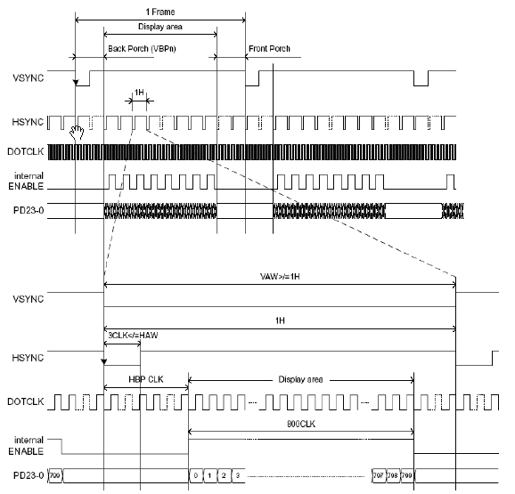
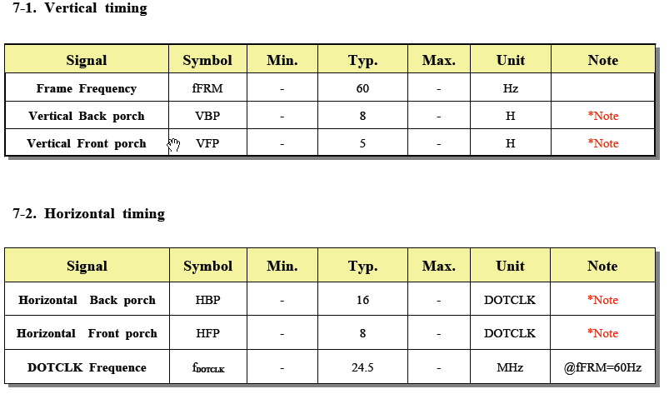
LCD 드라이버 수정-3
static struct s3cfb_lcd lte480wv = {
.width = 800,
.height = 480,
.bpp = 24,
.freq = 60,
.timing = {
.h_fp = 8,
.h_bp = 13,
.h_sw = 3,
.v_fp = 5,
.v_fpe = 1,
.v_bp = 7,
.v_bpe = 1,
.v_sw = 1,
},
.polarity = {
.rise_vclk = 0,
.inv_hsync = 1,
.inv_vsync = 1,
.inv_vden = 0,
},
};
drivers/video/samsung/s3cfb_lte480wv.c
에서 LCD datasheet 타이밍만 맞추면 됨

Slide 6
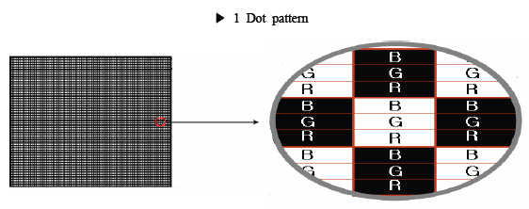
LCD 드라이버 수정-4
static int s3cfb_init_global(void)
{
fbdev->output = OUTPUT_RGB;
fbdev->rgb_mode = MODE_BGR_P;
fbdev->wq_count = 0;
init_waitqueue_head(&fbdev->wq);
mutex_init(&fbdev->lock);
s3cfb_set_output(fbdev);
s3cfb_set_display_mode(fbdev);
s3cfb_set_polarity(fbdev);
s3cfb_set_timing(fbdev);
s3cfb_set_lcd_size(fbdev);
return 0;
}

Slide 7
이더넷 드라이브 포팅-1
static struct resource s3c_smsc911x_resources[] = {
[0] = {
.start = S5PC1XX_PA_SMSC9220,
.end = S5PC1XX_PA_SMSC9220 + SZ_1M - 1,
.flags = IORESOURCE_MEM,
},
[1] = {
.start = IRQ_EINT11,
.end = IRQ_EINT11,
.flags = IORESOURCE_IRQ,
},
};
arch/arm/plat-s5pc1xx/devs.c 에서 수정
#define S5PC1XX_PA_SMSC9220 (0xA0000000)
/arch/arm/mach-s5pc100/include/mach/map.h

Slide 8
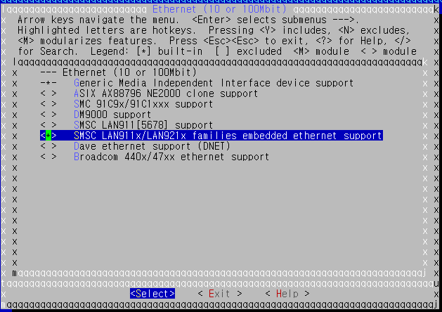
이더넷 드라이버 포팅 -2
“Device driver->Network Device support에서 선택
Configuration 파일 drivers/net/Kconfig 위치

Slide 9
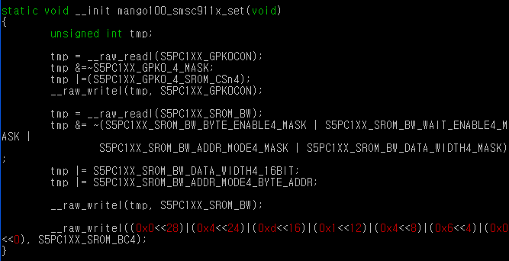
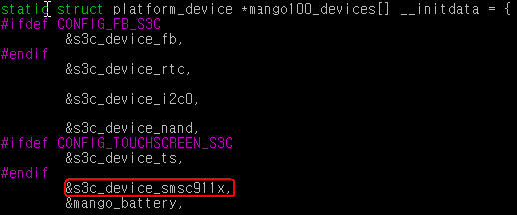
이더넷 드라이버 -3
./arch/arm/mach-s5pc100/mach-mango100.c
디바이스 등록 소스는
./arch/arm/plat-s5pc1xx/devs.c
에 위치

Slide 10
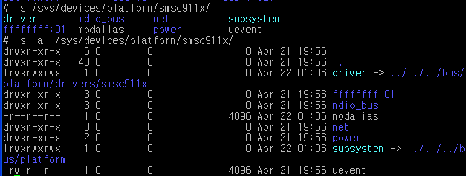
이더넷 디바이스 확인 방법

Slide 11
이더넷 드라이버 확인 방법

Slide 12
이더넷 드라이버 irq 등록확인
S5pc100 user manual에는 11번째에
EINT11이다, 근데 등록은 32를 더한 값인
43번째 등록이 되어 있다.
이유는 커널이 32번까지 spurious
인터럽트로 등록하여 사용한다.
#define IRQ_EINT11 S5PC1XX_IRQ_VIC0(11)
./arch/arm/plat-s5pc1xx/include/plat/irqs.h

Slide 13
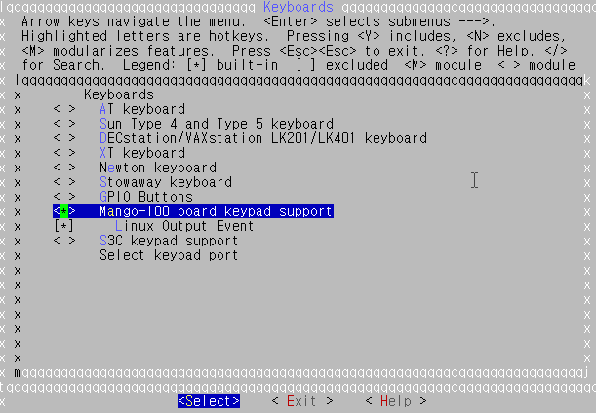
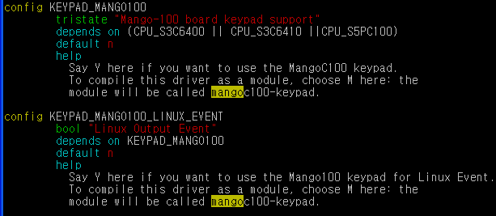
Keypad driver
./driver/input/keyboard/Kconfig 에 추가
.config 파일에
CONFIG_KEYPAD_MANGO100_LINUX_EVENT=y

Slide 14
Keypad driver
./driver/input/keyboard/ 파일을 추가한다.
./driver/input/keyboard/Makefile 에 추가

Slide 15
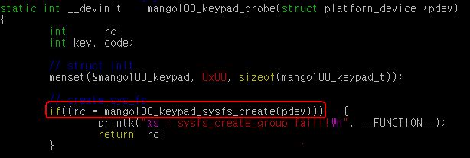
Keypad driver
Driver/input/keyboard/mango100-keypad.c
등록확인은 아래와 같이 확인 할 수 있다.

Slide 16
Keypad driver
struct input_event {
struct timeval time;
__u16 type;
__u16 code;
__s32 value;
};
./include/linux/input.h에 정의
#define EV_KEY 0x01
#define KEY_BACK 158 /* AC Back */
키를 누르면 value값은 1을 가진다
# hexdump /dev/input/event0
Key 누를경우
Key Release

Slide 17
Keypad driver
mango100_keypad.driver->name = DEVICE_NAME;
mango100_keypad.driver->phys = "mango100-keypad/input0";
mango100_keypad.driver->open = mango100_keypad_open;
mango100_keypad.driver->close = mango100_keypad_close;
mango100_keypad.driver->id.bustype = BUS_HOST;
mango100_keypad.driver->id.vendor = 0x16B4;
mango100_keypad.driver->id.product = 0x0701;
mango100_keypad.driver->id.version = 0x0001;
#define BUS_HOST 0x19
./include/linux/input.h
./drivers/input/keyboard/mango100_keypad.c 소스에 mango100_keypad_prob함수에 정의
# cat /proc/bus/input/devices
I: Bus=0019 Vendor=16b4 Product=0701 Version=0001
N: Name="mango100-keypad"
P: Phys=mango100-keypad/input0
S: Sysfs=/class/input/input0
U: Uniq=
H: Handlers=kbd event0
B: EV=3
B: KEY=40000800 0 0 0 0

Slide 18
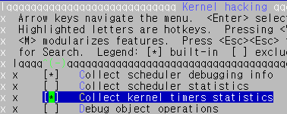
Keypad driver
“Kernel hacking “ 설정
CONFIG_TIMER_STATS=y 로 설정
To activate the collection of stats
# echo 1 > /proc/timer_stats
# cat /proc/timer_stats
Timer Stats Version: v0.2
Sample period: 2.911 s
291, 1 swapper mango100_keypad_config (mango100_rd_timer_handler)
2, 1 swapper schedule_delayed_work_on (delayed_work_timer_fn)
8, 1867 er.ServerThread futex_wait (hrtimer_wakeup)
3, 1 swapper phy_start_machine (phy_timer)
3, 1832 zygote queue_delayed_work (delayed_work_timer_fn)
1, 0 swapper page_writeback_init (wb_timer_fn)
308 total events, 105.805 events/sec
# echo 0 > /proc/timer_stats
To stop collecting stats

Slide 19
Keypad driver flow
Button (Hardware)
10ms 마다 스캔
mango100_keypad.rd_timer
GET_KEYPAD_DATA
mango100_rd_timer_handler
generate_keycode
mango100_keypad_control
input_report_key
에서 이벤트 발생

Slide 20
안드로이드 Key event 처리
Key button Map 정의는 vendor\sec\mango100\mango100-keypad.kl
frameworks/base/libs/EventHub.cpp에 scan_dir,open_device 정의
KeyInputQueue( 1853): InputDeviceReader.run()
static const char *device_path = "/dev/input";
bool EventHub::openPlatformInput(void)
{
..
res = scan_dir(device_path);
..
}
int EventHub::scan_dir(const char *dirname)
{
while((de = readdir(dir))) {
strcpy(filename, de->d_name);
open_device(devname);
}
}
int EventHub::open_device(const char *deviceName)

Slide 21
안드로이드 Key event 처리
export ANDROID_ROOT /system
/init.rc에 정의
int EventHub::open_device(const char *deviceName)
{
…
const char* root = getenv("ANDROID_ROOT");
property_get("persist.sys.keylayout", keylayout, "qwerty");
snprintf(keylayoutFilename, sizeof(keylayoutFilename),
"%s/usrkeylayout/%s.kl", root, keylayout);
strcpy(devname, keylayout);
bool defaultKeymap = access(keylayoutFilename, R_OK);
if (defaultKeymap) {
snprintf(keylayoutFilename, sizeof(keylayoutFilename),
"%s/usr/keylayout/%s.kl", root, "qwerty");
strcpy(devname, "qwerty");
}
LOGI("2:devname = %s, keylayout =%s, keylayoutFilename = %s",
devname, keylayout, keylayoutFilename);
device->layoutMap->load(keylayoutFilename);
….
}
I/EventHub( 1853): 2:devname = qwerty,
keylayout =qwerty,
keylayoutFilename = /system/usr/keylayout/qwerty.kl
-#logcat 명령으로 디버깅 메시지 출력
frameworks/base/libs/ui/EventHub.cpp파일에
EventHub::open_device함수에 정의

Slide 22
안드로이드 Key event 처리
int EventHub::open_device(const char *deviceName)
{
…
LOGI("New keyboard: publicID=%d device->id=0x%x devname='%s' propName='%s' keylayout='%s'\n",
publicID, device->id, name, propName, keylayoutFilename);
}
LOGI("New device: path=%s name=%s id=0x%x (of 0x%x) index=%d fd=%d classes=0x%x\n",
deviceName, name, device->id, mNumDevicesById, mFDCount, fd, device->classes);
LOGV("Adding device %s %p at %d, id = %d, classes = 0x%x\n",
deviceName, device, mFDCount, devid, device->classes);
}
frameworks/base/libs/ui/EventHub.cpp 에 open_device 정의
#logcat 명령으로 출력 결과
I/EventHub( 1853): New keyboard: publicID=65537 device->id=0x10001
devname='mango100-keypad' propName='hw.keyboards.65537.devname' keylayout='/system/usr/keylayout/qwerty.kl'
I/EventHub( 1853): New device: path=/dev/input/event0 name=mango100-keypad id=0x10001 (of 0x2) index=2 fd=58 classes=0x1

Slide 23
안드로이드 Key event 처리
Key Event 처리 Thread
Thread mThread = new Thread("InputDeviceReader") {
public void run() {
if (DEBUG) Log.v(TAG, "InputDeviceReader.run()");
android.os.Process.setThreadPriority(
android.os.Process.THREAD_PRIORITY_URGENT_DISPLAY);
RawInputEvent ev = new RawInputEvent();
while (true) {
try {
InputDevice di;
// block, doesn't release the monitor
readEvent(ev);
boolean send = false;
boolean configChanged = false;
if (true) {
Log.i(TAG, "Input event: dev=0x"
+ Integer.toHexString(ev.deviceId)
+ " type=0x" + Integer.toHexString(ev.type)
+ " scancode=" + ev.scancode
+ " keycode=" + ev.keycode
+ " value=" + ev.value);
}
#logcat 메시지
I/KeyInputQueue( 1853): Input event:
dev=0x10001 type=0x1 scancode=158
keycode=4 value=1
Mango100-keypad.kl과 scancode값 일치
BACK 키 수행이 됨
./frameworks/base/services/java/
com/android/server/KeyInputQueue.java
파일에 정의

Slide 24
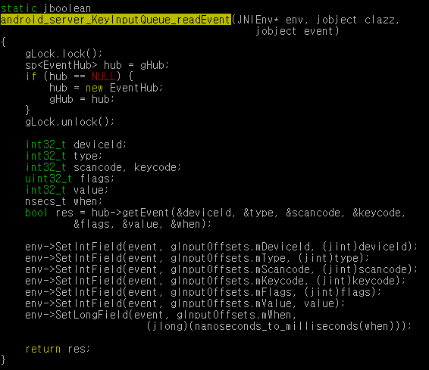
안드로이드 Key event 처리
frameworks/base/services/jni/
com_android_server_KeyInputQueue.cpp
frameworks/base/services/java/com/android/server/KeyInputQueue.java
Thread mThread = new Thread("InputDeviceReader") {
…..
while (true) {
try {
InputDevice di;
// block, doesn't release the monitor
readEvent(ev);
……

Slide 25
안드로이드 Key event 처리
public final boolean dispatch(Callback receiver, DispatcherState state,
Object target) {
switch (mAction) {
….
case ACTION_UP:
if (DEBUG) Log.v(TAG, "Key up to " + target + " in " + state
+ ": " + this);
if (state != null) {
state.handleUpEvent(this);
}
return receiver.onKeyUp(mKeyCode, this);
public void handleUpEvent(KeyEvent event) {
final int keyCode = event.getKeyCode();
if (DEBUG) Log.v(TAG, "Handle key up " + event + ": " + this);
./frameworks/base/core/java/android/view/KeyEvent.java
에서 dispatch를 한다.
#logcat 수행 결과
KeyEvent( 1910): Key up to android.inputmethodservice.InputMethodService$InputMethodSessionImpl@43da0b40 in
android.view.KeyEvent$DispatcherState@43d92cf8: KeyEvent{action=1 code=4 repeat=0 meta=0 scancode=158 mFlags=8}
V/KeyEvent( 1910): Handle key up KeyEvent{action=1 code=4 repeat=0 meta=0 scancode=158 mFlags=8}: a
ndroid.view.KeyEvent$DispatcherState@43d92cf8
D/MountListener( 1853): handleEvent ums_connected

Slide 26
안드로이드 Key Event 처리
Window Manager
distpatchKey(KeyEvent..)
frameworks/base/services/java/com/android/server/WindowManagerService.java
Thread mThread = new Thread("InputDeviceReader")
readEvent(ev);
di = newInputDevice(ev.deviceId);
frameworks/base/services/java/com/android/server/KeyInputQueue.java
static JNINativeMethod gInputMethods[] = {
/* name, signature, funcPtr */
{ "readEvent", "(Landroid/view/RawInputEvent;)Z",
(void*) android_server_KeyInputQueue_readEvent },
frameworks/base/services/jni/com_android_server_KeyInputQueue.cpp
static const char *device_path = "/dev/input";
bool EventHub::getEvent(int32_t* outDeviceId, int32_t* outType,
bool EventHub::openPlatformInput(void)
frameworks/base/libs/ui/EventHub.cpp

