Slide 1
망고100 보드로 놀아보자-10
망고100 NAND ,SD map

Slide 2
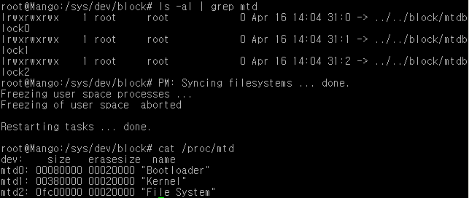
망고100 NAND Partition 영역
0x00000000
U-boot
(/dev/mtdblock0)
Creating 3 MTD partitions on "NAND 256MiB 3,3V 8-bit":
0x000000000000-0x000000080000 : "Bootloader"
0x000000080000-0x000000400000 : "Kernel"
0x000000400000-0x000010000000 : "File System“
--커널 부팅 시 메시지
0x80000
Kernel
(/dev/mtdblock1)
커널소스 위치는
256MB
0x400000
부팅 후 확인 방법
#cat /proc/mtd
Filesystem
(/dev/mtdblock2)
0x10000000

Slide 3
SD /MMC Partition 구성
FAT32(2.4GB)
1
Disk /dev/mmcblk0: 3941 MB, 3941597184 bytes
4 heads, 16 sectors/track, 120288 cylinders, total 7698432 sectors
Units = sectors of 1 * 512 = 512 bytes
GNOME FS(500MB)
Android FS(500MB)
Fdisk 명령으로 파티션을 만든다
Mkfs.ext3 /dev/sdb1
Mkfs.ext3 /dev/sdb2
Mkfs.ext3 /dev/sdb3
Mount -t ext3 /dev/sdb2 /media/android
파일시스템 복사
TSECTORS-9266
Kernel
(4MB)
3941MB
TSECTORS-1074
U-boot
(512KB)
TSECTORS-34
U-boot ENV
(16KB)
TSECTORS-18
Bootloader
(9KB)
TSECTORS=7698432 sectors

