Slide 1
IOT Zigbee 테스트

Slide 2
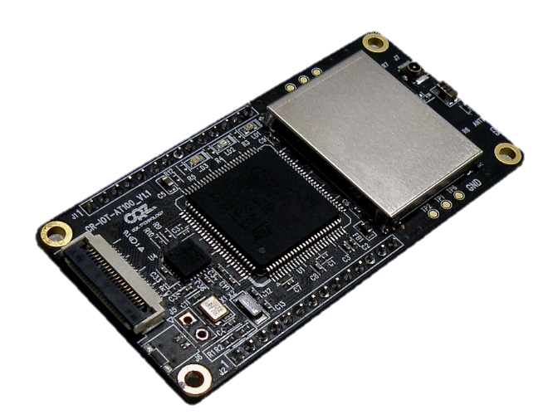
2.4GHz Wireless
LED Control

