Slide 1
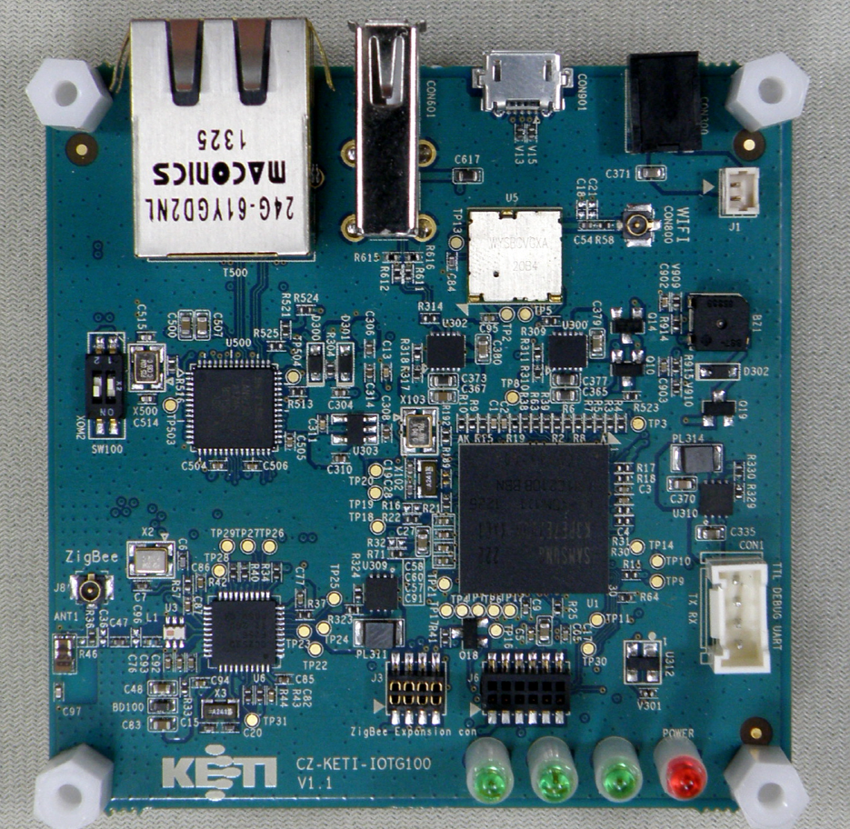
USB 2.0 Host
RJ45(Ethernet)
USB Device
DC 5V, 2A
Wi-Fi/BT
BOOT SWITCH
Samsung Cortex-A9
S5PC210 Dual Core
CC2530 Zigbee
DEBUG (UART 1 )
Sensor Connector
Zigbee Download Connector

Slide 2
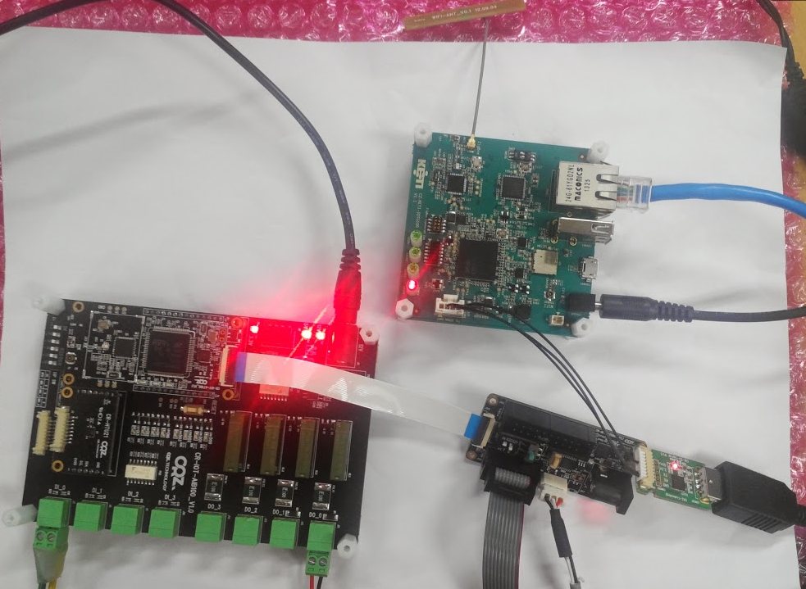
CR-IOTG100
CR-IOT-AT100

Slide 3
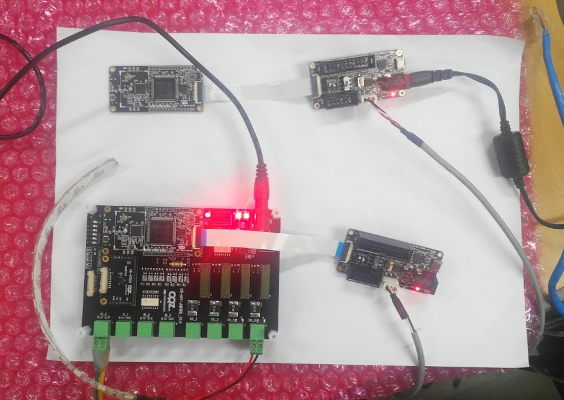
bin_device_115200
이미지 Write
bin_coordinator_115200
이미지 Write

